Slide 1

Chapter 9
Spatial Statistics
Notes:
This chapter presents a range of statistics and algorithms that can be used to compare two spatial data sets. These are important for modelling because, at some point, it will be necessary to compare a model outcome to some real-world data in order to assess the reliability of the model. This chapter examines the statistics themselves, before Chapter 10 elaborates on how to evaluate the success of a model more broadly, part of which includes making use of the methods discussed here.

Slide 2
Learning Objectives
By the end of this chapter, students will be able to:
Identify some commonly-used statistics that can be used to quantify the difference between spatial data sets.
Explain which are the most appropriate statistics for use in comparing aggregate data and point data.
Explain four different ways of identifying the differences in spatial data sets: visual comparison; descriptions of point patterns; global difference; local difference.
Calculate the value of these statistics.

Slide 3
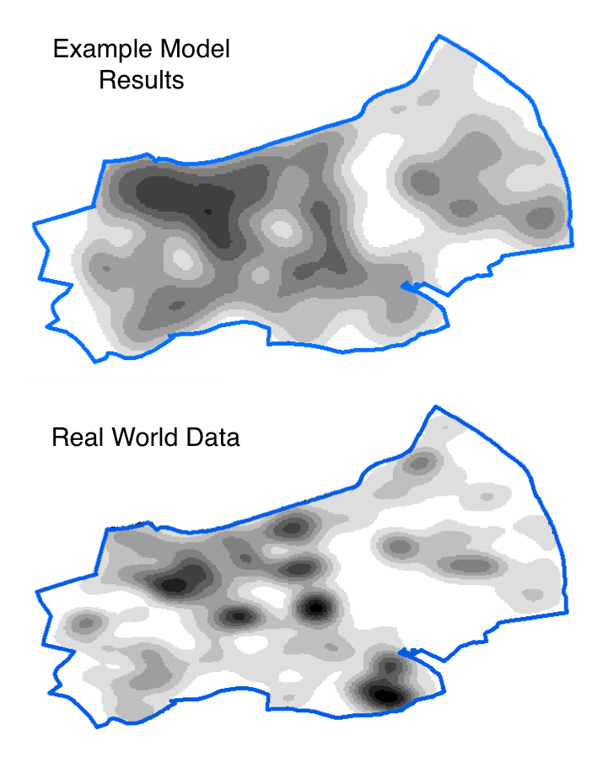
Introduction
All models are wrong, but some are useful (Box, 1979)
We often need to compare two spatial data sets:
For example: Model results compared to real-world data
There are many ways to do this
Choosing the most appropriate method is vital
This lecture will introduce and compare a number of different ‘goodness of fit’ statistics.

Slide 4
Overview
Goodness of fit and hypothetical data
Global Statistics
Visual Comparisons
Point Pattern Statistics
Local Statistics (LISA)
Conclusions

Slide 5
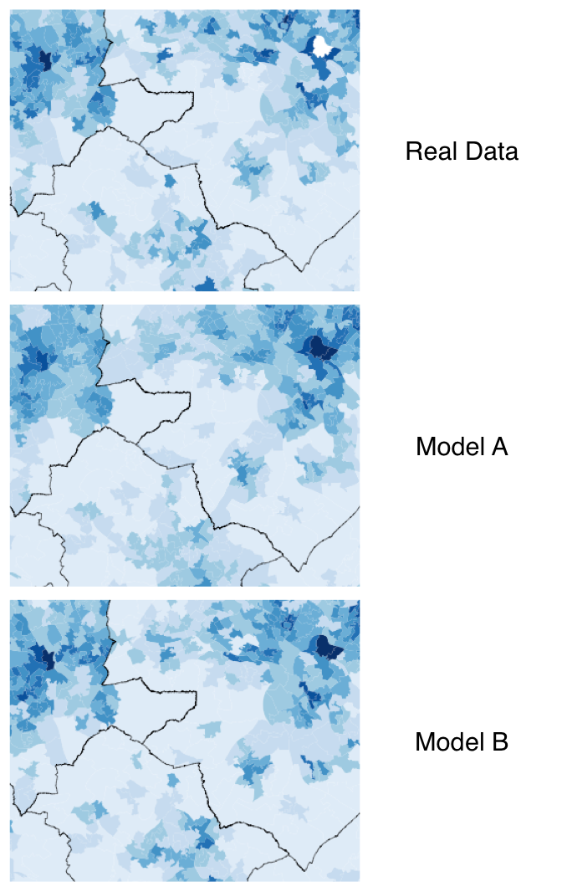
Goodness of Fit
Assessment of how well a model fits a set of observations.
Humans are quite good at comparing patterns visually.
But often it is better to use quantitative methods.
E.g.: which of the two models on the right is better – A or B?

Slide 6
Statistics that Will be Introduced
Notes:
● Global statistics (Section 9.3) – statistics that calculate the overall difference
between two data sets (e.g. the total error);
● Visual comparisons (Section 9.4) – methods that provide visual outputs and allow spatial data sets to be compared visually;
● Description of point data (Section 9.5) – statistics that describe the properties of point data, such as the degree of clustering;
● Local indicators of spatial association (Section 9.6) – statistics that calculate the difference between two data sets at a local spatial level.

Slide 7
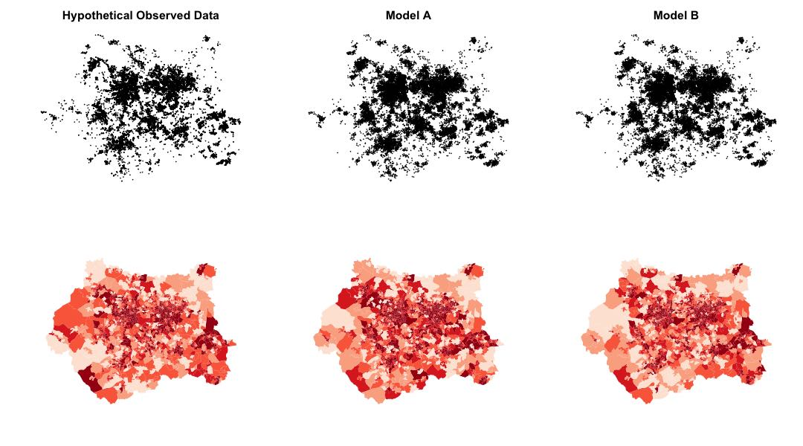
Hypothetical Data
To experiment with the different statistics, three datasets will be used. They are all point patterns.
‘Observed’ data – real data
(This is actually some real crime data for Leeds, UK).
Model A – data that could have come from a simulation.
Model B – data that could have come from a simulation with slightly different parameters.

Slide 9
Hypothetical Data
When the data were created, the points in Model B data were deliberately made more similar to the real data than those from Model A.
In other words, Model B is ‘better’ than Model A.
The statistics used throughout this chapter later should show this.
The results of two hypothetical models (A and B) plotted against observed data. The lines of best fit (y = x) illustrate the locations of ‘perfect’ model results. In this example, model B is a better fit to the observed data than model A.

Slide 10
Overview
Goodness of fit and hypothetical data
Global Statistics
Visual Comparisons
Point Pattern Statistics
Local Statistics (LISA)
Conclusions

Slide 11
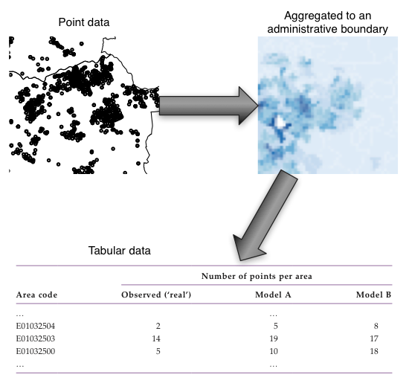
Global Statistics
There are many statistics that can quantify the difference between two datasets.
Typically they are applied to tables or matrices.
They can be applied to spatial data if the points are aggregated to some boundary to create a table.
Common to use administrative boundaries (e.g. from a population census).

Slide 12
Global Statistics: Residual Sum of Squares
Add together the square of the differences between the observed and simulated values:
Y_{i}’ is the simulated value in cell i
Y_{i} is the real value in cell i
Disadvantages:
Large errors can be inflated
The magnitude of the cell count influences the statistic.
A small percentage differences in cells with lots of points is given a very large error value.

Slide 13
Global Statistics: Root Mean Square Error (RMSE)
Standardised Root Mean Square Error (SRMSE) was found to be the best performing (Knudsen and Fotheringham, 1986).
RMSE is similar, but more readily available.
Range
0 - identical data
1 (or greater) – difference between data
Drawback: difficult to understand
What does RMSE = 0.34 mean?
How much better is a model with RMSE=0.30 than one with RMSE=0.35 ?

Slide 14
Global Statistics: R²
The proportion of agreement between a model and the observed data
R²=0.34 means the model is able to explain 34% of the variation in the real data
Range
0 – no agreement (big differences)
1 – identical data
Drawbacks:
Insensitive to overall amount of error
Unreliable for non-linear models

Slide 15
Results: RSS, R², RMSE
All agree that Model B is a closer fit to the real data than Model A.
lower SRMSE values indicate greater agreement, whereas higher R2 values indicate greater agreement
Main lesson: the choice of statistic matters for error calculation!

Slide 16
Overview
Goodness of fit and hypothetical data
Global Statistics
Visual Comparisons
Point Pattern Statistics
Local Statistics (LISA)
Conclusions

Slide 17
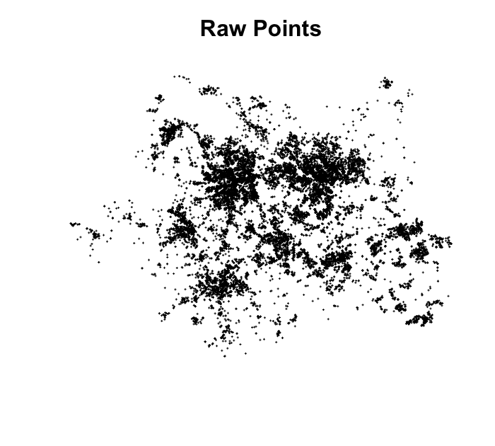
Visual Comparisons
Humans are very good at comparing images.
‘Face validation’: visualising model results and examining the patterns.
Need to decide on the best way to display the data.
For large datasets, it is difficult (impossible?) to discern a spatial pattern from the raw points data.

Slide 18
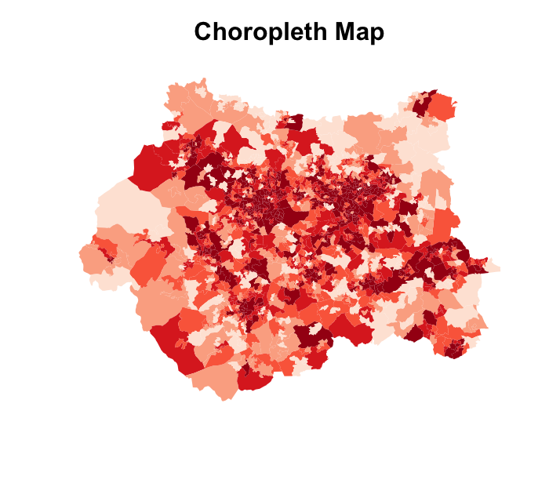
Visual Comparisons: Choropleth Maps
Points can be aggregated to an administrative boundary.
Then a choropleth map can be produced.
Advantage: the aggregated data can be used directly by global statistics.
Disadvantages:
The eye can be drawn to large, bright areas disproportionately;
They are susceptible to the Modifiable Areal Unit Problem (MAUP).

Slide 19
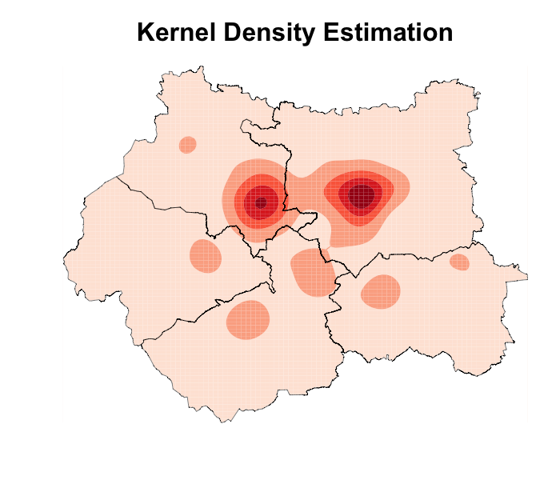
Visual Comparisons: KDE
Kernel Density Estimation (KDE)
Place a regular grid over the point pattern.
Calculate the density of points in each cell that are within a distance (aka the ‘kernel’).
Large kernel: smooth surface
Small kernel: more variation
Probably the best method for comparing point patterns

Slide 20
Overview
Goodness of fit and hypothetical data
Global Statistics
Visual Comparisons
Point Pattern Statistics
Local Statistics (LISA)
Conclusions

Slide 21
Describing the Properties of Point Patterns
Aggregating points to administrative areas means that we lose information.
It is preferable to work with point patterns directly.
One way to do this is to examine the amount of clustering in two datasets.
The methods wont say where the clusters are, but can estimate how much clustering there is.

Slide 22
Clustering in Point Patterns
Simplest way to quantify clustering is through nearest neighbour methods.
Calculate the distance from each point to its nearest neighbour.
In clustered data, points are usually close to their neighbours.
In uniform data, the distances are usually longer.
Point patterns attribution: Yerpo CC BY-SA 4.0, from Wikimedia Commons.

Slide 23
Nearest Neighbour Index (NNI)
The mean minimum nearest neighbour distance, d_{min}, is the average distance between each point, i, and its nearest neighbour, j:
The mean minimum distance that would be generated if the points were produced by an entirely random spatial process:
A simple way to calculate the degree of clustering.
Measure the distance between each point (i) and it’s nearest neighbor (j).
Compare the mean minimum distance to that which would be found if the points were generated by a random spatial process.
Range: 0 (all points are at the same location) to 2.15 (entire spatial uniformity).
The nearest neighbour index is the ratio of the mean minimum distance to that which would be produced by a random process

Slide 24
Nearest Neighbour Index (NNI)
Model B has a similar degree of clustering to the Observed data.
Model A has less clustering / more uniformity (a higher NNI value).
As expected, this suggests that Model B is creating data that are more similar to the Observed data than Model A.
NNI Drawbacks:
Susceptible to edge effects (points near the edge will have higher distances
Only considers one distance, the minimum, so lots of information is lost

Slide 25
Ripley’s K Function
Takes all of a point’s neighbours into account.
Count the number of neighbours near to a point and divide by the overall point density.
Larger values of K(d) imply more clustering.
Graphs of K(d) show how clustering changes with distance.
The index works by counting the number of neighbours within a given distance, d, from each point s_{i}.
The value of K at distance d is then calculated as the mean of all counts divided by the overall point density.

Slide 26
Ripley’s K: Results
Graph shows how clustering changes with distance.
Again, Model A has a similar amount of clustering to the Observed data.
Model B is more uniform at all but the smallest distances.
Drawback with nearest neighbour statistics:
Only describe the amount of clustering, not where the clusters occur

Slide 27
Overview
Goodness of fit and hypothetical data
Global Statistics
Visual Comparisons
Point Pattern Statistics
Local Statistics (LISA)
Conclusions

Slide 28
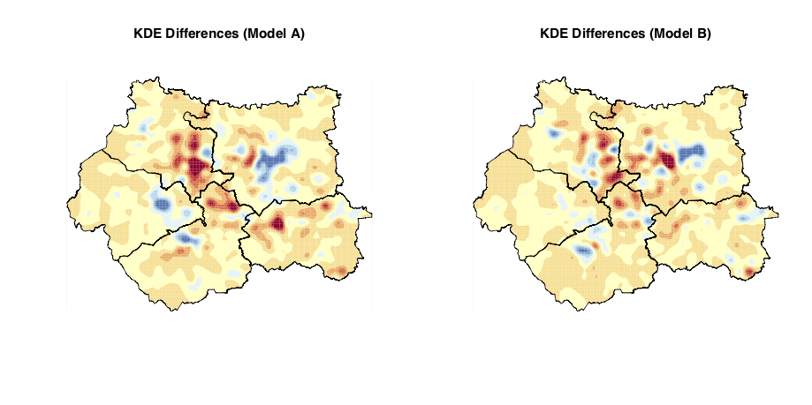
Local Indicators of Spatial Association (LISA)
Local Statistics – show where clusters are.
Can be used to see if the model is creating clusters in the same places as those in the observed data.

Slide 29
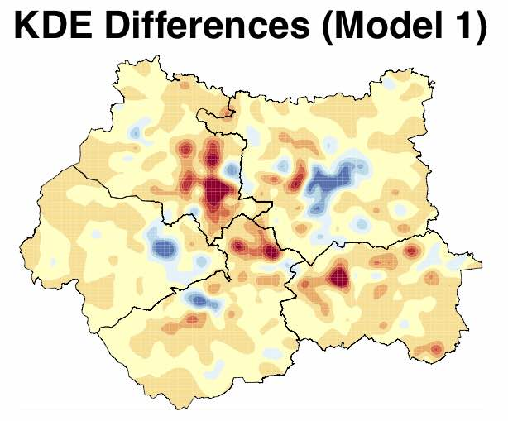
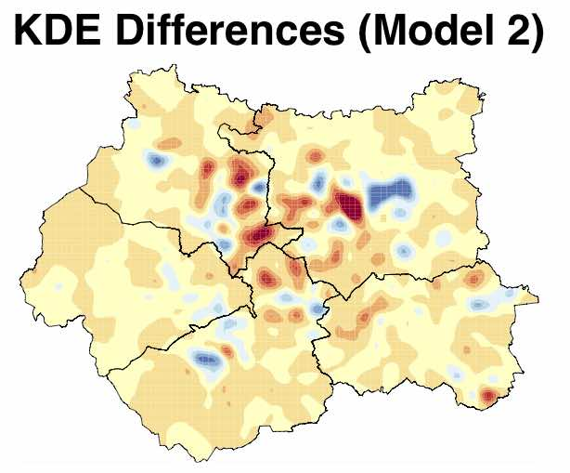
LIDA Example: KDE Differences
Simple example: calculate two density surfaces and take one away from the other.
Shows where the density of a model is different to that of the observed data.
Not ‘clustering’ per se.
Useful to see where the model is under/over predicting.

Slide 30
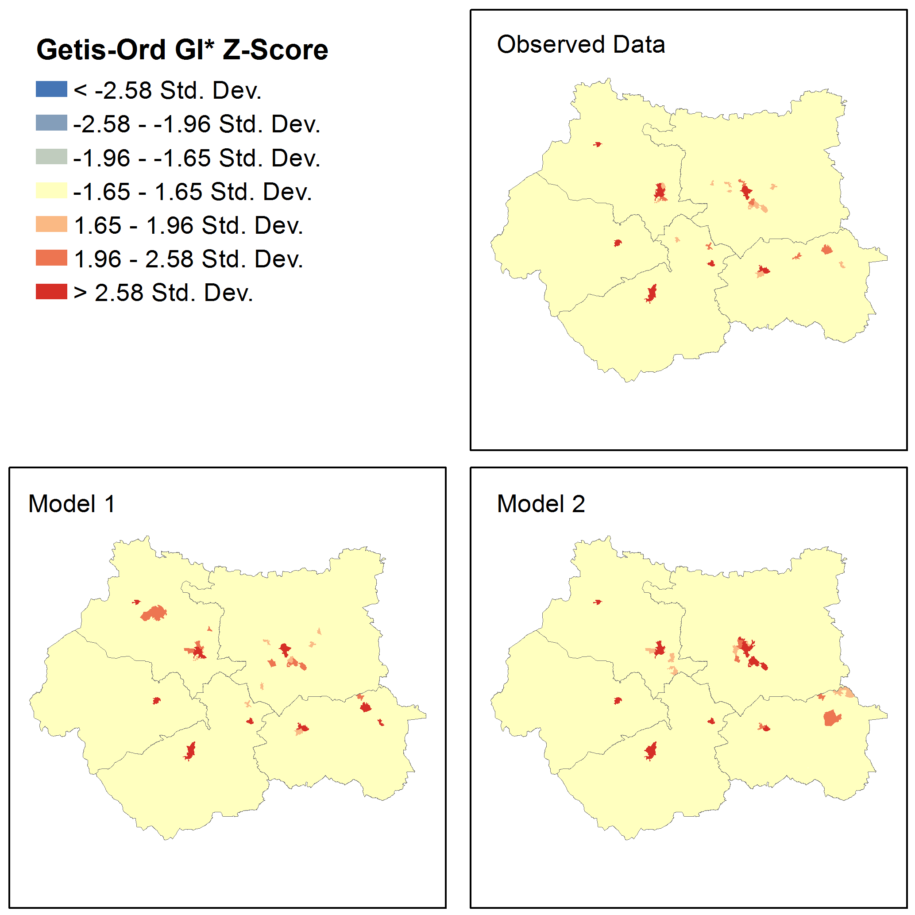
Local Indicators of Spatial Association (LISA): GI*
GI* - Estimates the locations of ‘hot’ and ‘cold’ spots:
Hot spots: there are significantly more points than in the surrounding areas.
Cold spots: significantly fewer points.
Gives statistical significance of cluster.
GI* Results:
The data are largely similar (few statistically significant clusters).
There are some locations in the simulated data where hotspot locations vary slightly.
Could now try to work out why some modelled hotspot locations are different to the real data…

Slide 31
Overview
Goodness of fit and hypothetical data
Global Statistics
Visual Comparisons
Point Pattern Statistics
Local Statistics (LISA)
Conclusions

Slide 32
Conclusions
It is often necessary to compare spatial model results to observed data:
Visually (e.g. comparing maps);
Global statistics (quantifying the difference);
Point pattern statistics (e.g. quantifying the amount of clustering);
LISA (identifying the locations of clusters).
Choosing an appropriate method and statistic is vital!
The next lecture will demonstrate how these statistics are used in earnest for model calibration and validation.

Slide 33
Further Reading
For a detailed review a range of spatial statistics and to learn more about the methods presented here, readers are referred to:
O’Sullivan, D. and Unwin, D. (2010) Geographic Information Analysis (2nd edn). Hoboken, NJ: John Wiley & Sons.
For more details about the pros and cons of a number of the goodness-of-fit statistics discussed here, including the root mean square error and R2, readers are referred to the seminal paper:
Knudsen, D.C. and Fotheringham,A.S. (1986) Matrix comparison, goodness- of-fit, and spatial interaction modelling. International Regional Science Review, 10(2), 127–147.
While targeted mainly at a crime analyst audience, the following book discusses a number of useful methods that can be used for mapping spatial data:
Chainey, S. and Ratcliffe, J. (2005) GIS and Crime Mapping. Chichester: John Wiley & Sons.
For a broad and up-to-date review of the difficulties in analysing agent-based model outputs and in particular the analysis of time, readers are referred to:
Lee, J.-S., Filatova,T., Ligmann-Zielinska,A., Hassani-Mahmooei, B., Stonedahl, F., Lorscheid, I.,Voinov, A., Polhill, G., Sun, Z. and Parker, D.C. (2015) The complexities of agent-based modelling output analysis. Journal of Artificial Societies and Social Simulation, 18(4), 4. Available at http:// jasss.soc.surrey.ac.uk/18/4/4.html.
Much of the statistical analysis in this chapter was derived from the excellent textbook:
Brunsdon, C. and Comber, L. (2015) An Introduction to R for Spatial Analysis and Mapping. London: Sage.

Slide 34
Glossary
Goodness of fit – a broad description for statistics that quantify how well a model fits a set of real-world observations.
RSS – residual sum of squares; a statistic that estimates the overall difference between two data sets by summing the square of the errors.
R2 – ‘R squared’; a statistic that estimates the overall difference between two data sets.
(S)RMSE – (standardised) root mean square error; a statistic that esti- mates the overall difference between two data sets.
KDE – kernel density estimation; a means of estimating point density at a particular location. Often used to draw maps of point patterns.
LISA – local indicators of spatial association; statistics that can estimate the locations of local clusters (areas with a higher than expected point density).
NNI – nearest neighbour index; measures global spatial uniformity (i.e. the overall amount of clustering in a point pattern). Also known as the Clark and Evans R statistic (Clark and Evans, 1954).
Ripley’s K function; another measure for global spatial uniformity (i.e. the overall amount of clustering in a point pattern).
GI* – a statistic that estimates the spatial locations of ‘hot’ (e.g. high) and ‘cold’ (e.g. low) spot

Slide 35

Online Resources
Visit: www.abmgis.org/Chapter9.html for a selection of models to highlight core concepts introduced in this chapter

